Slide 1
FY1314 Network Budget Allocation
March 7, 2014
Central Florida Cares Health System, Inc.
Notes:
Welcome. Thank you for those of you that consolidated attendees.
Presentation: Quick overview of how CFCHS develops the network budget in absence of a competitive environment.
Once Needs Assessment finalized and gaps identified, will start to see more solicitations on our website.

Slide 2
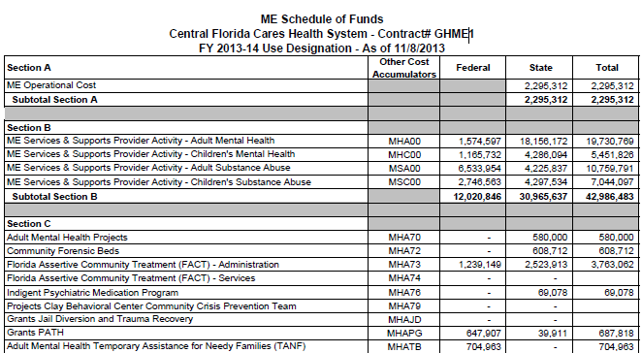
Notes:
Pictured here is the schedule of funds exactly as received in our contract #GHMEI with DCF. (I had to remove the a few lines from section C to fit on the slide, but you get the idea.)
3 Sections drive CFCHS’s network budget.
Section A is the ME Admin allocation, which is NOT a function of the total contract amount as originally negotiated with DCF.
Section B is mostly general revenue funding with the least amount of restrictions on how it can be drawn down.
Section C is OCA specific funding with specific use restrictions.
CFCHS nor the network have any flexibility in any of these sections or their corresponding OCAs.

Slide 3
How does CFCHS set up the Network Budget?

Slide 4
1. Enter SOF allotments
Notes:
1. Enter allotments from the Schedule of Funds by program and by OCA

Slide 5
2. Enter base amounts from DCF assignment letters.
Notes:
2. Enter each contract’s base amount from the DCF assignment letters 7/1/2012.
At this point we are just focusing on the network’s bottom line for each program (AMH, CMH, ASA, CSA). We balance the bottom line first, and then work towards balancing individual OCAs.

Slide 6
3. Calculate budget differences.
Notes:
The spreadsheet automatically calculates the difference between the network base and the schedule of funds budget from DCF.
As you can see here, we are approximately 1.5 million short in AMH. But keep in mind the network base has not accounted for the ME Admin or any legislative budget reductions for the year.

Slide 7
4. Calculate proportionate share of each contract.
Formula: Contract base / Total base
Notes:
In order to work towards balancing the budget, we must determine each contract’s percentage in relation to the network total.
4. The spreadsheet automatically calculates the proportionate share of each contract using the formula of contract base / network base for each program individually.
In this example: Contract C is a provider of substance abuse services only. Therefore, it is logical that Contract C has a 0% share of AMH. However, Contract C’s percentage will be different in ASA and CSA.
Checks and balances: The spreadsheet shows that the contract percentages for this program = 100%

Slide 8
5. Translate to dollars and adjust bottom line.
Notes:
5. Next, we translate the percentages to dollars to show how the bottom line must be adjusted for each contract to balance the AMH budget.
As you can see in this example, if we adjust:
$6717 from contract A’s base
$302 from contract B’s base
And so on….
We will arrive at a total AMH budget of $26,144,402 for the network, which is in line with our budget for AMH from DCF.

Slide 9
How does CFCHS adjust each contract to get to the bottom line?
Notes:
SO in review:
We have plugged in our budget from DCF for each program (AMH, CMH, ASA, and CSA.)
We have plugged in individual contract base amounts from assignment letters.
We have calculated our bottom line difference for each program.
And we have calculated each contract’s bottom line adjustment in order to balance our network budget to the DCF budget.
So how will the bottom line adjustments look WITHIN each contract?

Slide 10
1. Adjust in Section B where possible.
Notes:
Recall from the first slide that Section B is mostly funded with general revenue is the funding with the least amount of restrictions on its use.
Therefore, make as much of our adjustment in section B of each contract as possible.
So for this example:
Contracts A and B, we will deduct $6717 and $302 respectively from section B funding in each of those contracts.
Contract C requires no deduction in AMH, but we will adjust ASA and CSA later.
Contract D has both Section B and Section C funding. So we will deduct the full $331,544 from Section B of the contract.
Contract E poses a problem – Contract E has $0 Section B funding. Its AMH funding is solely in Section C. So where do we deduct Contract E’s share of the network’s adjustment to balance the budget? It would not be fair and equitable to spread Contract E’s $38,233 adjustment to Contracts A, B, and D.

Slide 11
Budget: Post Balance
Notes:
Well, we attempt to deduct if from Section C OCA MHATB as a last resort. “Attempt” is the key work here. CFCHS has put in a contract amendment request to DCF to accommodate this adjustment and other similar “last resort” adjustment in other OCAs. We are still waiting to hear the outcome of that request, but we amending contracts in good faith that the request will be granted.
So this is what our budget looks like “post balance”. We have created a negative difference in Section B and a positive difference in Section C due to Contract E (and Contract X that you cannot see) being funded solely by Section C funding.
Notice the bottom line balances. This is GOOD!

Slide 12
ME / DCF Contract Amendment
Notes:
So if you remember from the first slide, our DCF budget comes to us in 3 sections.
Section A is the section dedicated solely to the ME Admin fee.
New this year, the ME Admin allocation is NOT a function of the total contract amount. Therefore, the ME Admin allocation played NO role in the calculations on the spreadsheet. And it is virtually impossible to “back into” individual contract amounts using a ME Fee percentage – so do not try to do that.
After much deliberation and many spreadsheet scenarios, we have determined that the process we have demonstrated today is the fairest and most equitable way to fit our square peg (historical contract bases) into a round hole (our DCF budget).

Slide 13
Questions?
Central Florida Cares Health System. Inc.

