Slide 1
Central Florida Cares Health System Incidental Expenses

Slide 2
Overview
What are Incidental Expenses?
Incidentals Expense Funding
Transitional Voucher Requirements
Pre-Authorization
Pre-Authorization Form Requirements
Reporting Requirements
Incidental Monitoring
Subcontractor Policy & Procedures Recommendations

Slide 3
i. What are Incidental Expenses?
DEFINITION: Per 65E-14.021 F.A.C. temporary expenses incurred to facilitate continuing treatment and community stabilization when no other resources are available. Allowable purchases under this Covered Service include: transportation, childcare, housing assistance, clothing, educational services, vocational services, medical care, housing subsidies, pharmaceuticals and other incidentals as approved by the Managing Entity.
PURPOSE: The purpose of incidental expenses is to facilitate the continuation of treatment and community stabilization when no other resources are available.
PROCEDURE CODES: The following provides some, but not limited to, allowable expenses and its pertaining procedure codes are listed in the following link: https://centralfloridacares.org/asset/2020/04/Incidental-Expenses-Procedure-Codes.pdf
Funding cannot be “gifted” to individuals served in any form. Providing a gift card, a monetary reward or gift of any sort is not allowed with government funds.

Slide 4
II. Incidental Expense Funding
Incidental Expenses are allowable under many different Other Cost Accumulators (OCA’s). Some examples of OCA’s which are eligible for the billing of Incidental Expenses are MH000, MH0PG, MH0CN, MHTRV, MS000, MS0CN, MSTRV, MSTVS, MSTV2.
DCF Data Pamphlet 155-2 Data Codes: FASAMS (myflfamilies.com)
If requesting to include incidental expenses in a program, the provider would need to submit a program description and include the expenditures in their budget. CFCHS would then need to review and approve both the program description and budget, prior to implementing in a program.
If approved, the cost center would then need to be amended into the contract funding detail within the approved OCA.

Slide 5
Iii. Transitional Voucher Requirements
Use of Transitional Voucher funding refer to DCF Guidance 29, Guidance 29 Transitional Vouchers 2021 07 01.pdf (myflfamilies.com) for requirements and allowability of Incidental Expenses.
Transitional Vouchers offer time-limited financial assistance up to one year (12 months from initial use) to support consumer-driven services based on the person’s needs assessment and care plan objectives.
Individual must be engaged in services, must meet financial eligibility requirements, be referred to SOAR to assist in SSI/SSDI.
The Transitional Voucher is intended to assist eligible individuals obtain and maintain accessible, affordable housing with supportive recovery services.
Request for substance use housing vouchers can only be used for Association of Recovery Residences (FARR) certified homes or housing operating under the Oxford House Model.
Notes:
M

Slide 6
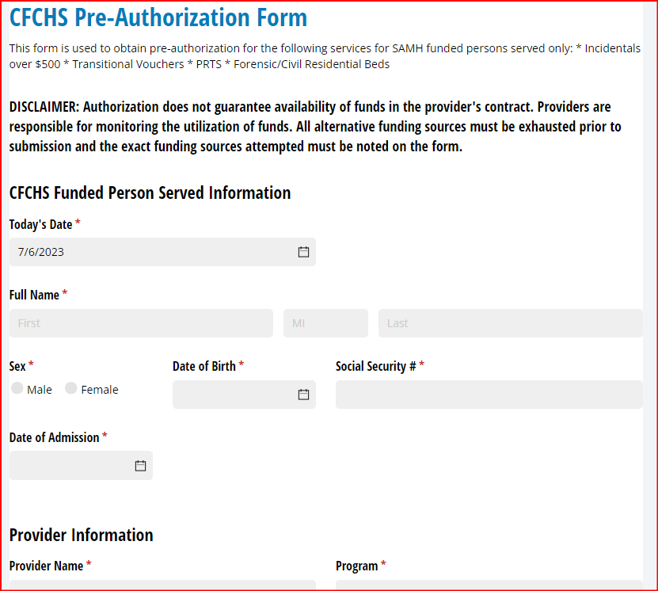
iV. Pre-Authorization
Expense(s) of $500 or more requires a preauthorization for reimbursement. CFCHS will deny requests that are not preauthorized or are for services from prior months.
All requests are to be submitted via Incidental/Residential Pre-Authorization Request Form
Authorization does not guarantee availability of funds in the provider's contract. Providers are responsible for monitoring the utilization of funds. For additional questions, see your assigned contract manager.
Once received, CFCHS will review and respond within five business days. If approved, CFCHS will email a secure copy of the authorization to be kept on file no later than day five after the submission or provide a pending status update

Slide 7
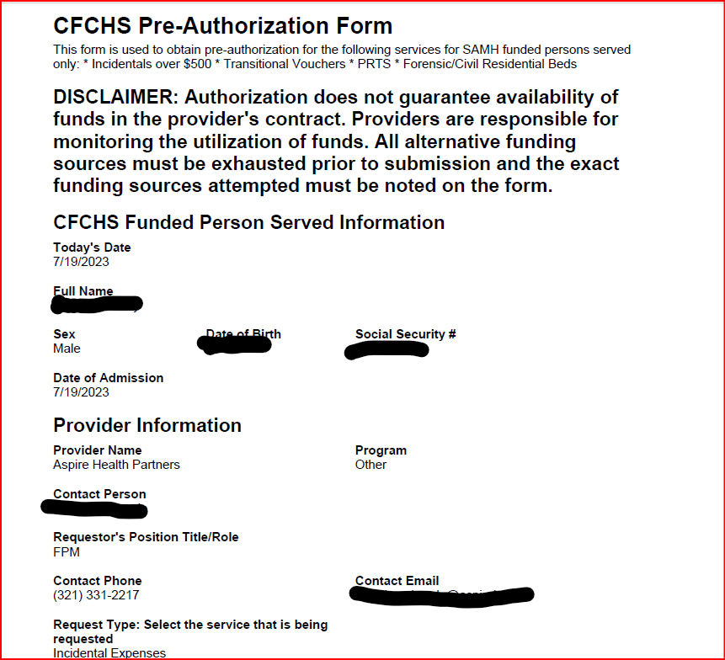
V. Pre-Authorization Form Requirements
Pre-Authorization is to be kept in the individual’s file with receipts of expenses and payment incurred (i.e. check hard copy/credit card statement)
Date of Admission Field = date the individual was admitted (program expenses will be deducted from)
Supervisor signature required
May request up to 3 months of advance rent payments for housing. IEC00: Incidental Expenses – Housing.
Ensure to break down costs (i.e. requesting $800 x 3 months for a total of $2400 and a nonrefundable rent deposit of $1600 = $4000.00 total)
CFCHS performs file reviews at time of monitoring or as necessary
The approval of incidental expenses is generated, and documented, in accordance with the process established by CFCHS. Each Subcontractor is to maintain a written policy and process of its own.
Documentation of objective or treatment goal funds will be utilized for from the individualized service plan/treatment plan

Slide 8
VI. Reporting requirements
Payment methodology of incidental expenses:
Data submission to cfchsdata.org
CF-MH 1040 form to be reimbursed for incidental expenses
All backup documentation to be kept on file for audit purposes
Provider would pay in advance, payment is in arrears
Transitional vouchers funding requires the additional submission of a quarterly report utilizing DCF Template 32, Template 32 TRV Incidental Report 2023 09 18.xlsx (live.com).

Slide 9
VII. Monitoring incidental expenses
CFCHS conducts annual monitoring which include the review of the items listed below. Specific monitoring tools can be found using the following link: https://centralfloridacares.org/providers/#uagb-tabs__tab5
Policies and Procedures
Service Validation of Individual Served Records
Source Documentation to include but not limited to: Invoice Date, Receipt, Associated Case/Treatment Plan Goal, and CFCHS approval.
Notes:
The monitoring tool for policies and procedures https://centralfloridacares.org/asset/2023/09/Policy-and-Procedures-.xlsx
For next FY year the Incidental and Transitional Voucher section of the Administrative tool will be subject to review and reviewed. The present time would be a good time to update your agency’s policies to reflect this information.

Slide 10
VIII. Subcontractor Policy & Procedures
Ensure that the policy and procedure includes the elements listed below:
Supports the definition and approved expenses of Incidental Expenses as described in 65E-14 F.A.C.
Indicates that Incidental Expenses should be used for expenses within your catchment area but not to exceed the counties that CFCHS serves.
Includes if the agency intends to use Incidental Expenses for housing assistance. If so, then you will need to address how refundable security deposits are handled and documented and specified on the CFCHS pre-authorization form: https://centralfloridacares.org/providers/incidental-pre-authorization/
Describes the need for incidentals is documented within the care/treatment plan and only if all other resources have been exhausted and should only be requested if the need is reasonable, allowable, and necessary.

Slide 11
VIII. Subcontractor Policy & Procedures cont.
Includes the step-by-step instructions for reimbursement of expenses for any approved vendors along with verification of payment to validate billing to CFCHS.
Includes steps for addressing incidental expenses exceeding $500. The following link may be helpful for this: https://centralfloridacares.org/asset/2022/03/Incidental-Expense-Pre-Authorization.pdf
It is required that all requests include an internal approval provided from a supervisor authority.
H. Include verbiage which states incidentals for recovery housing that is utilizing State Opioid Response (SOR) funds, can only be used on approved Florida Association of Recovery Residences (FARR) certified homes or Oxford Homes.

Slide 12
Questions
Preauthorization process
Miralys Martinez, Risk Management Specialist
mmartinez@cfchs.org
Geovanna Gonzalez, Compliance Director
ggonzalez@cfchs.org
contract managers
Leo Colomer, Contract Manager
lcolomer@cfchs.org
Lillie Hopkins, Contract Manager
lhopkins@cfchs.org

