Slide 1
Central Florida Cares
Onboard Training

Slide 2
Contracts Onboard Training RV 1.27.25

Slide 3
Overview
Origin of CFC
About CFC
Purpose of CFC
Contract Agreement
Required Reports
ConcordNow Contract Management
Invoice and Payment

Slide 4
Origin of CFC
Who We Are:
In 2012, Central Florida Cares (CFC) was designated by the Florida Department of Children and Families (DCF) as the Behavioral Health Managing Entity (ME) to administer a regional system of mental health and substance use care for the following circuits:
Circuit 9 (Orange & Osceola Counties)
Circuit 18 (Seminole & Brevard Counties)

Slide 5
About CFC
What We Do:
As an ME, CFC does not provide direct services but funds a services network comprised of organizations that offer various levels of behavioral health treatment for adults, children, as well as families. Treatment options include but are not limited to:
Prevention
Intervention
Crisis Support
Residential Treatment
Outpatient Services, to include opioid and medication assisted treatment
Supportive Housing

Slide 6
Purpose of CFC
Mission:
The mission of CFC is to provide an affordable, high-quality behavioral health care system for persons with mental health and/or substance use disorders.
Vision:
The vision of CFC is to achieve a comprehensive and seamless behavioral health system that promotes recovery and resiliency.

Slide 7
Contract Agreement

Slide 8
Contract Agreement
The purpose of this section is to become familiar with the agreement for the provision of Substance Abuse and Mental Health services in accordance with the details from the subcontract agreement and the Master Contract between Central Florida Cares (CFC) and the Florida Department of Children and Families (DCF) Central Region.
The review of this section will include the following:
Contract Dashboard
Important Contract Clauses
Reference Documents
Contract Obligations

Slide 9
Contract Agreement
Contract Dashboard
Each agreement executed with a Service Provider will include the following details:
Contract Number
Contract Amount
Local Match Requirement (If applicable)
Contract Lifecyle

Slide 10
Contract Agreement
Important Contract Clauses
It is important for the Provider to become familiar with all terms of the contract; however, the areas below include important details.
(Section A) Service Delivery
(Section B) Method of Payment
(Section D) Compliance with Standard Federal Provisions
(Section E.) Compliance with Standard State Provisions
(Section I.) Termination
(Section N.) Renewals
(Section P.) New Programs

Slide 11
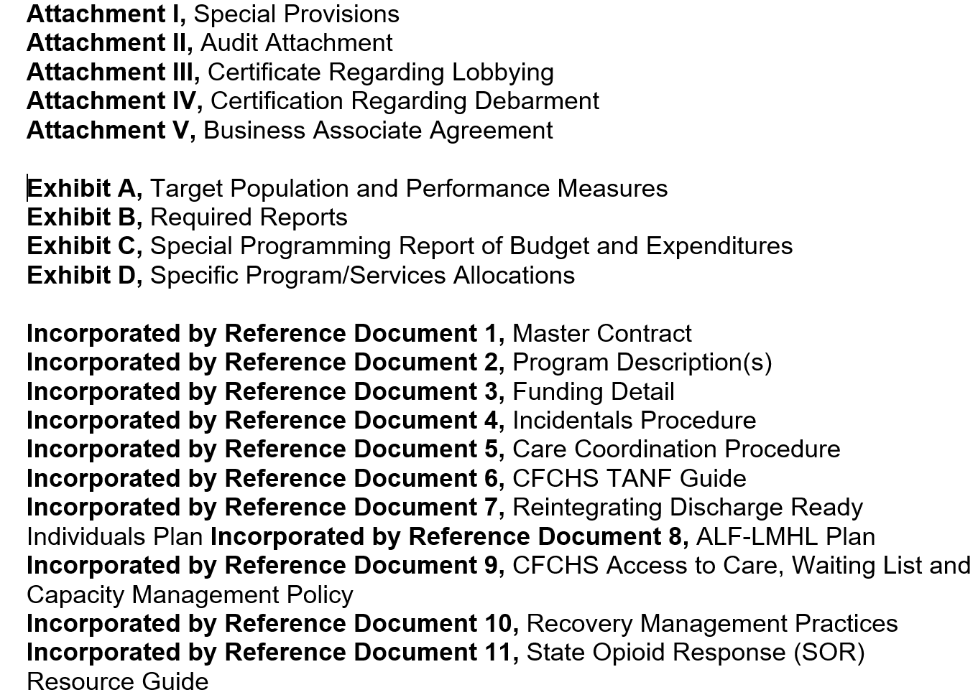
Contract Agreement
Referenced Documents
The following documents (if applicable), or the latest revisions thereof, will be incorporated by reference and made part of the subcontract agreement.

Slide 12
Contract Agreement
Contract Obligations
The following includes important contract obligations under subcontract agreement:
A(2)(a) - Subcontractors must comply with any and all provisions applicable to Subcontractor as set out in the Master Contract and Exhibits as subsequently modified by amendments, which are incorporated into the subcontract.
A(2)(g) - Subcontractor shall provide deliverables, including reports and data as specified in the included Attachments and Exhibits, in accordance with the stated standard terms and conditions of the contract. The failure to comply is considered a breach of contract as specified in the Master Contract and could result in denial of payment until acceptable deliverables are received.

Slide 13
Required Reports

Slide 14
Required reports
The purpose of this section is to become familiar with the required report which are incorporated by reference and found in Exhibit B of the Provider Subcontract document package. The review of this section will include the following:
Required Reports
Required Report Examples
Report Tracking System (RTS)
Exhibit B Cross Walk

Slide 15
Required reports
Required Reports:
All network provider subcontracts include Exhibit B: Required Reports, which illustrates important information such as Report Name, Due Dates, Applicability, and Frequency. The six frequencies of Required Reports are listed below:
Upon Contract Execution
Annual
Semi-Annual
Quarterly
Monthly
Ad-Hoc

Slide 16
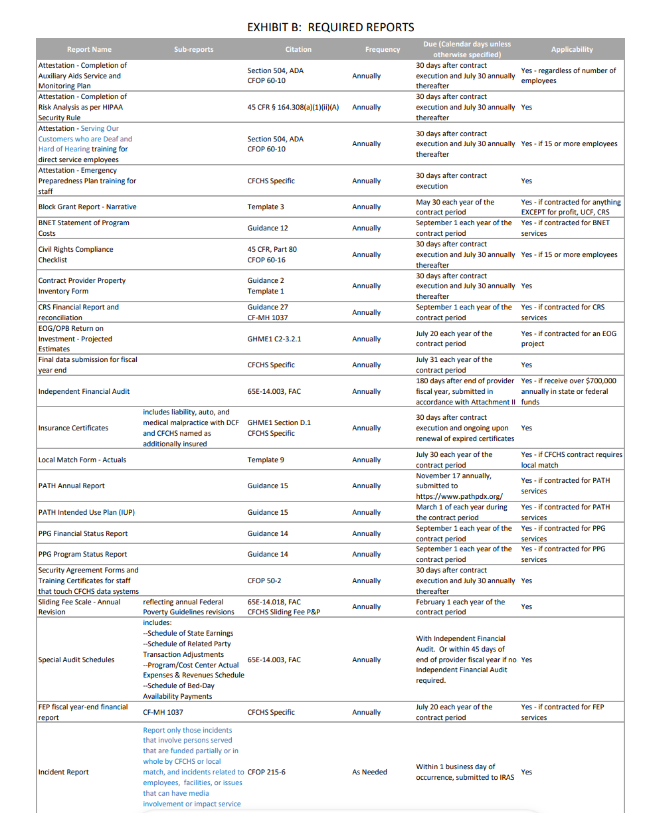
Required reports
Required Reports (Continued):
There are 70+ reports listed in Exhibit B. Therefore, it is recommended that you reach out to your CFC Contract Manager if you have questions about which ones are applicable to you.
General reminders of required reports from Exhibit B are sent out as a courtesy by the CFC contract management department.

Slide 17
Required reports
Required Reports Examples:
Below are a few examples of required reports:
# | Report | Reports due Upon Contract Execution
1 | Attestation | Request example from CFC Contract Manager
2 | Fiscal Reports | Guidelines | Templates | Forms – Mental Health Substance Abuse Services (centralfloridacares.org)
3 | Program Descriptions | Program description and organizational profile templates – Mental Health Substance Abuse Services (centralfloridacares.org)
4 | Qualifying and Procurement Documentation | Request example from CFC Contract Manager
5 | Non-Disclosure Form | https://www.myflfamilies.com/sites/default/files/2023-03/Access%20Confidentiality%20and%20Nondisclosure%20Agreement%200521.pdf

Slide 18
Required reports
Required Reports Examples (Continued):
Below are a few examples of required reports:
# | Report | Semi-Annual Required Report Form(s)
1 | Block Grant Data Report | https://www.myflfamilies.com/document/53041
# | Report | Annual Required Report Form(s)
1 | Attestations | Request example from CFC Contract Manager
2 | Updated Certificates of Insurance | Request example from CFC Contract Manager
3 | Financial Audit | Request example from CFC Contract Manager
4 | Required/Refresher Training Certifications | Security Awareness, HIPAA, Deaf and Hard of Hearing trainings can be accessed by clicking here: https://www.myflfamilies.com/my-fl-learn

Slide 19
Required reports
Required Reports Examples (Continued):
Below are a few examples of required reports:
# | Report | Quarterly Required Report Form(s)
1 | Exception Attestation | Guidelines | Templates | Forms – Mental Health Substance Abuse Services (centralfloridacares.org)
2 | ROI Reports (only for appropriation projects) | https://www.myflfamilies.com/sites/default/files/2023-06/Template%2030%20ROI%20Report%202021%2007%2001.pdf
3 | Community Action Treatment (CAT) | https://www.myflfamilies.com/sites/default/files/2025-01/Guidance%2032%20-%20CAT.pdf
4 | Invoice Reconciliation and Support Information (CF-MH 1040). | This includes a copy of a general ledger and trial balance for allowable expenditures.
5 | NVRA Activities Reports | NVRA Voter Registration Agencies Quarterly Activities Report Form – Mental Health Substance Abuse Services (centralfloridacares.org)

Slide 20
Required reports
Required Reports Examples (Continued):
Below are a few examples of required reports:
# | Report | Monthly Required Report Form(s)
1 | Program Data Report | https://cfchsdata.org/Public/Logon?ReturnUrl=%2f
2 | Census and Wait List | Most forms can be found in guidance or templates from the following website: https://www.myflfamilies.com/services/samh/providers/managing-entities/managing-entities-fy24-25-templates
3 | Auxiliary Aids Service Records (HHS) | https://fs16.formsite.com/DCFTraining/Monthly-Summary-Report/form_login.html
# | Report | Ad-Hoc Required Report Form(s)
1 | Incident Reports | Provided by CFC Risk Management Specialist. Review process for IR here ---> https://vimeo.com/552588687
2 | Response to Monitoring/Corrective Action Plans | Provided by CFC Quality Assurance Specialist

Slide 21
Required reports
Report Tracking System (RTS):
CFC has created a user-friendly Report Tracking System to submit and track applicable Exhibit B Required Reports utilizing the following Cognito webpage:
https://www.cognitoforms.com/CentralFloridaCaresHealthSystemInc1/ReportTrackingSystemRTS
This process provides efficient visibility of live actions and timely report performance progress by integrating the following functions:
Provider contact information
Report upload
Notifications
You may also find the RTS PowerPoint presentation along with other helpful training material on our website by accessing the following link:
Guidelines | Templates | Forms – Mental Health Substance Abuse Services (centralfloridacares.org)

Slide 22
Required reports
Exhibit B Crosswalk:
A crosswalk spreadsheet with all reports listed in the Exhibit B can be accessed by clicking on the link below. The crosswalk provides information on how each report on the Exhibit B is named in the new Report Tracking System (RTS) and/or if a report is required to be submitted through a system other than RTS.
https://centralfloridacares.org/wp-content/uploads/2024/03/Exhibit-B-with-Crosswalk-to-RTS_2-16-2024.xlsx

Slide 23
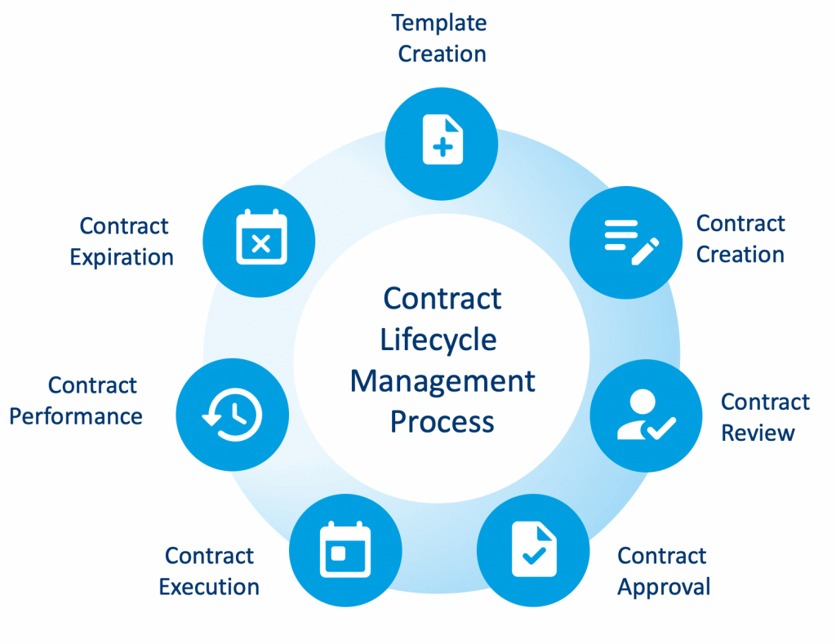
ConcordNOW cONTRACt Management

Slide 24
ConcordNOW CONTRACT management
Below are the following areas that will be covered in this section regarding ConcordNow Contracts Management Software:
Concord Overview
System Access Information
Contract Review
Contract Execution

Slide 25
ConcordNOW CONTRACT management
CONCORDNOW OVERVIEW:
ConcordNow is a Contract Management Software that allows the ability to create, collaborate, sign, and manage all contracts in one platform. CFCHS utilizes the Concord Contract Management Software for the following purposes:
To provide contracts and contract amendments for Providers to review and sign.
To collaborate, negotiate, and ensure compliance of the Department and Managing Entities requirements with Provider Network.
To store and share executed contracts.

Slide 26
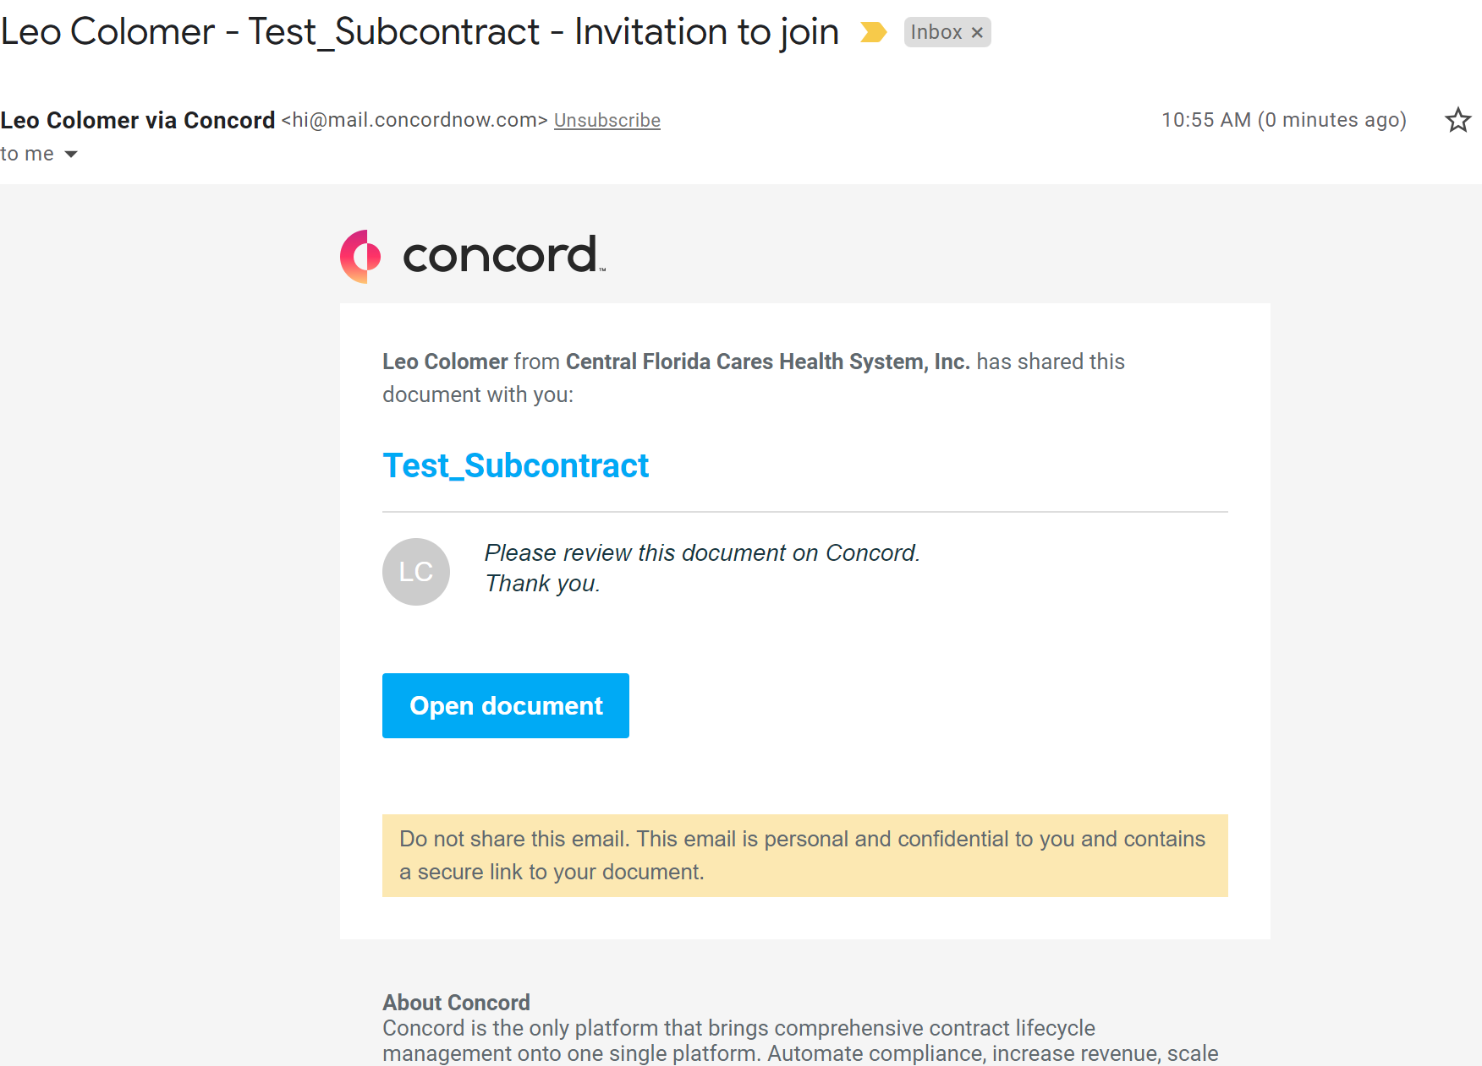
ConcordNOW CONTRACT management
SYSTEM ACCESS INFORMATION:
Once the Provider Representative with signature authority along with the user for joint review is determined, CFC will send an invitation to the e-mail on file. This will allow the assigned representatives to access the contract/amendment within the system to review and sign.
The link to access the website is listed below: ConcordNow.com

Slide 27
ConcordNOW CONTRACT management
CONTRACT REVIEW:
CFC review:
The CFC Contract Manager (CM) will assign an appropriate contract number in the following format: XXXNN where XXX is an acronym of the subcontractor’s name and NN is the year in which the contract expires.
When applicable, the review process can request the review and approval from the CEO, COO, or other delegates.
Once contracts or amendments are approved by all requested CFC reviewers, the contract is loaded into the contract management software (currently ConcordNow) for review and signature by both parties.

Slide 28
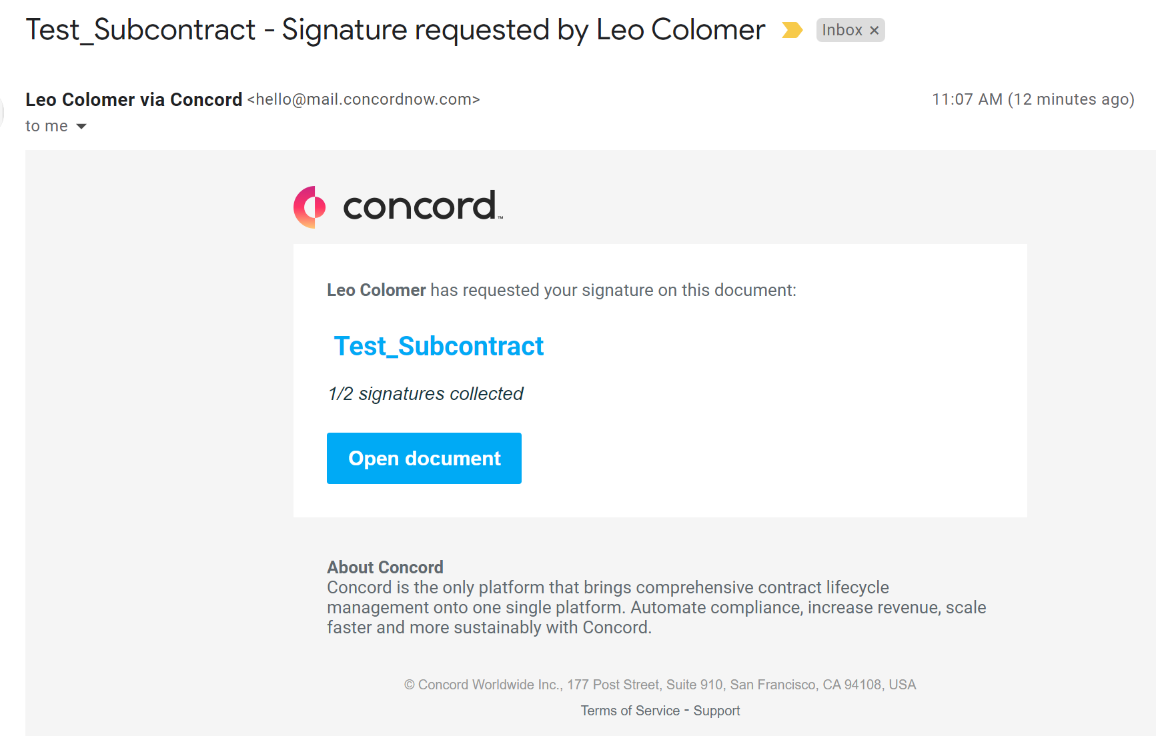
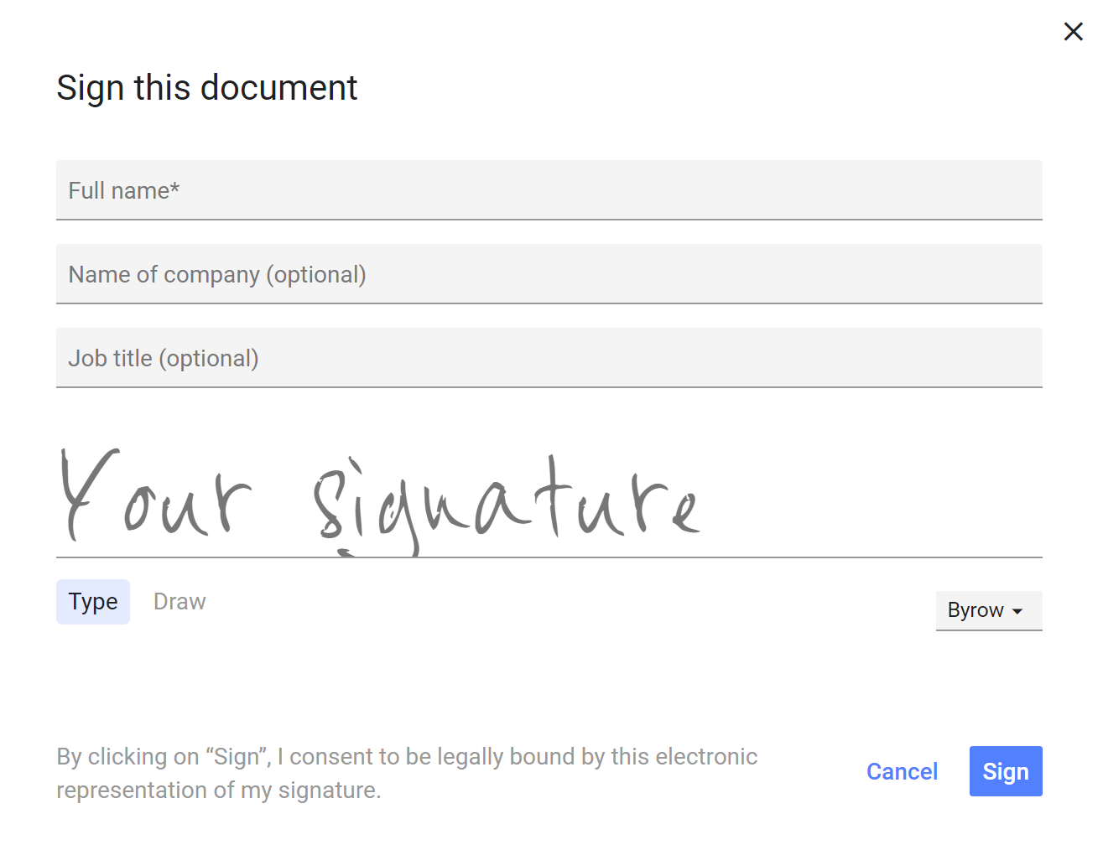
ConcordNOW CONTRACT management
CONTRACT REVIEW CONTINUED…
Provider review:
Multiple users from the Provider may join and review the document.
Only one Provider Representative with signature authority may sign the document. NOTE: The signer for the subcontractor must have the authority to commit the organization to terms of the contract.
Once the document has been joined and reviewed, the Provider Representative will receive a SECOND automatic e-mail from Concord requesting an electronic signature.

Slide 29
ConcordNOW CONTRACT management
CONTRACT EXECUTION:
After the provider signs the contract, the CFC CEO will then electronically sign the document.
This fully executed document is available for PDF download at any time and a copy will be e-mailed via assigned CFC Contract Manager.
All contract and amendment versions as well as contract attachments and exhibits are available on ConcordNow for your reference.
Revisions, Amendments, and Price-Level Increases to a contract must be clearly specified in the contract document.
Lapse (overutilization) Increases are subject to partial or all reimbursement after paying a Subcontractor their total contract amount. Lapse Increases do not require an amendment to the total contract amount.
Extensions, Renewals, and Terminations may be subject to a performance evaluation with the terms and conditions of the contract.

Slide 30
Invoice and Payment

Slide 31
Invoice and payment
Below are the steps for the monthly request of payments. As a reminder, payments are subject to the availability of funding.
Method of Payments
Data Reporting
Invoice Validation
Payment

Slide 32
Invoice and payment
METHOD OF PAYMENT
There are FOUR primary payment methods utilized when invoices are processed for CFC contracts:
Non-bundled Fee-for-service
Payment for units of service delivered in accordance with the terms and conditions of the subcontract at the unit price listed in the CFC approved funding details incorporated by reference. Rates in the funding detail are determined upon review and approval by CFC of fiscal reports. Payments are determined by using a Year-To-Date (YTD) method based on the following rules:
Availability Covered Services – Pay prorated amount regardless of service units delivered
Utilization Covered Services – Pay based on calculation of Unit Rate x YTD Units in Data System – YTD previous payments

Slide 33
Invoice and payment
METHOD OF PAYMENT (continued)
Bundled Fee-for-service with monthly/quarterly reconciliation
Upon review and approval of budget by CFC.
Payment for the reimbursement of services on the basis of expected cost.
A pro-rated monthly amount is calculated based on the budget amount. This is the amount paid monthly unless actuals are submitted every month.
CF-MH 1040 form is required to be submitted monthly or quarterly demonstrating actual expenses with a final reconciliation to include a copy of a general ledger and trial balance for CFC to be able to reconcile payments versus actual expenses, as well as to verify allowability of expenditures. Please keep in mind this reconciliation process could mean you will receive a lower or no payment for the pertaining month.

Slide 34
Invoice and payment
METHOD OF PAYMENT (continued)
Bundled Cost Reimbursement/Advance
Payment for the reimbursement of costs for implementation of program(s).
CF-MH 1038 Line-Item Operating budget must be submitted prior to payment. Review and approval of the form is required by CFC.
CF-MH 1040 must be submitted for payment.
Case Rate
Upon review and approval of budget by CFC.
Payment for the reimbursement of services on the basis of expected cost.
Based on a contractually defined package of services to be delivered within a defined period of time
A negotiated payment/rate for a clinically-defined episode of care per member for a specific range of services.

Slide 35
Invoice and payment
DATA REPORTING
Providers must submit data and/or the 1040 no later than midnight on the 5th
of the month following the month of services for the monthly request of payments.
Reporting data for non-bundled fee-for- service:
Units of services provided must reported to the applicable systems below for payment.
https://cfchsdata.org/Public/Logon?ReturnUrl=%2f
Prevention data is submitted to https://florida.prevention.systems/login
Reporting data for bundled fee-for-service and cost reimbursement:
Although the services are not paid based on data submitted, the contract still requires data to be submitted for services provided. Please submit data utilizing the following link: https://cfchsdata.org/Public/Logon?ReturnUrl=%2f
In some instances, there may be spreadsheets that include performance measures or data that we are not able to capture in the data system. If that applies, we must receive the spreadsheet for payment to be processed.

Slide 36
Invoice and payment
INVOICE VALIDATION
An electronic reverse invoice packet containing a check request for the payment of covered services together with the burn rate sheet (utilization trend of program expenditures) is processed for approval. A validation and approval process for both CFC and the Provider is completed to ensure accuracy of payments. If the Provider has earned more than the prorated amount for the month, the following rules apply:
Funded with Restricted Other Cost Accumulators (OCA’s) - Generally Pay what is earned until exhausted.
Funded with General Revenue – Generally pay up to the monthly target burn rate.

Slide 37
Invoice and payment
INVOICE VALIDATION CONTINUED…
CFC Invoice validation process:
CFC Contract Manager completes reverse invoice packet and routes document package for internal approval to CFC Contracts Director, COO, and CFO.
CFC Contract Manager enters approved reverse invoice packet information into the master invoice, which is completed for 100% of the provider network.
The Finance Department utilizes the master invoice and approved reverse invoice packets to generate subcontractor payments.
CFC Contract Manager sends monthly burn rate spreadsheet providing the approved monthly payments via e-mail to provider billing and contract point of contact; and copies the finance point of contact.

Slide 38
Invoice and payment
INVOICE VALIDATION CONTINUED
Provider Invoice approval process:
The Provider reviews the reverse invoice packet for accuracy
If there are any questions regarding the payments or data on the invoice, the Provider should contact their assigned CFC Contract Manager.
The Provider enters any sliding fees collected.
The Provider approves the document by signing electronically and returning the document to their assigned CFC Contract Manager.

Slide 39
Invoice and payment
PAYMENT
Invoice Payment Disbursement is completed by the CFC Finance Department.
Providers may be paid via check or Electronic Funds Transfer (EFT).
Providers must complete ‘Electronic Payment Authorization’ Form to set up EFTs. The form is available from your assigned CFC Contract Manager upon request.
Payments are typically processed and disbursed by the 27th of the month the invoice is provided.
Per CFC contract with DCF, the requirement states we shall make payments within 7 working days after receipt of payment from DCF. Meaning there may be months later in the FY where payments will occur later than the 27th.

Slide 40
Invoice and payment
For any additional questions or concerns regarding the Invoice and Payment Process, please contact your assigned CFC Contract Manager

Slide 41
Questions
Thank you!

Slide 42
Contact Information
Leo Colomer
Lead Contract Manager
lcolomer@cfchs.org
Office: (407) 985-3569
Cell: (407) 259-5388
Lillie Hopkins
Contract Manager
lhopkins@cfchs.org
Office: (407) 985-3563
Cell: (407) 867-2859

