Slide 1
Central Florida Cares Health System
Incident Report Training
Compliance Department

Slide 2
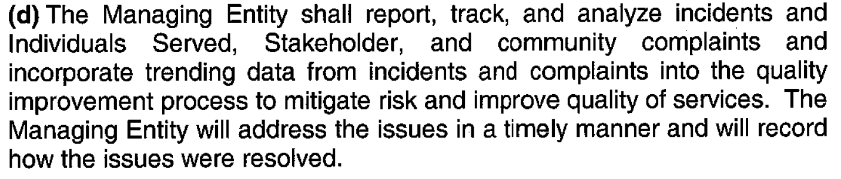
Contractual requirement
DCF General Contract:
CFCHS GHME2 Contract:
Provider’s Contract-Exhibit B: Required Reports

Slide 3
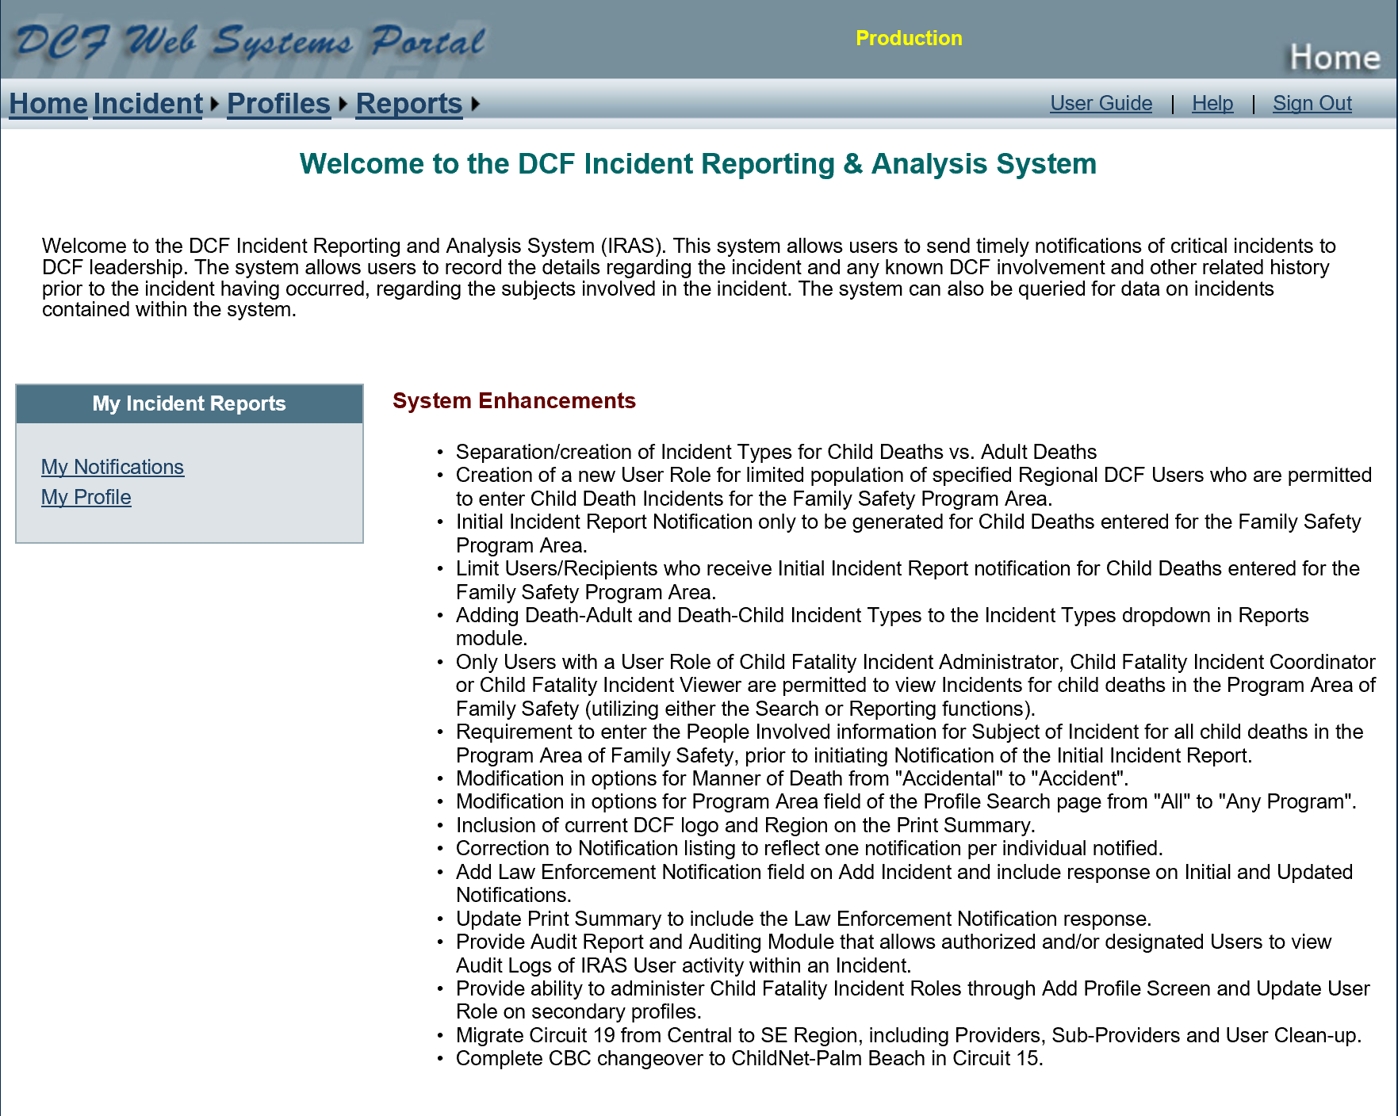
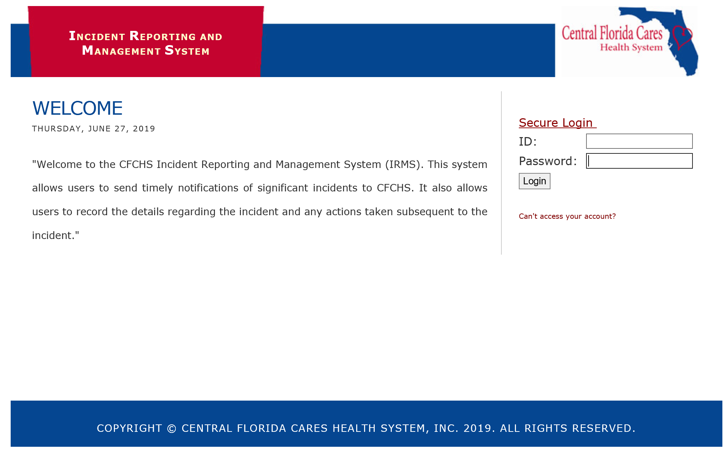
Incident Reporting systems CFC IRMS vs. DCF IRAS
DCF Incident Reporting Analysis System (IRAS): CFC CIO will provide login credentials and instructions for downloading Cisco AnyConnect VPN
CFC Incident Reporting Management System (IRMS): CFC Risk Management Specialist will provide User ID, password, and instructions
Disabling Access: Providers must notify CFC Chief Information Officer (MLupton@cfchs.org), within 24 hours, the need of employee access removal to the Department aka DCF and CFC data systems. This should be done by filling out the DCF Database Access Request Form available at Resources for Other DCF Applications | Florida DCF (myflfamilies.com)

Slide 4
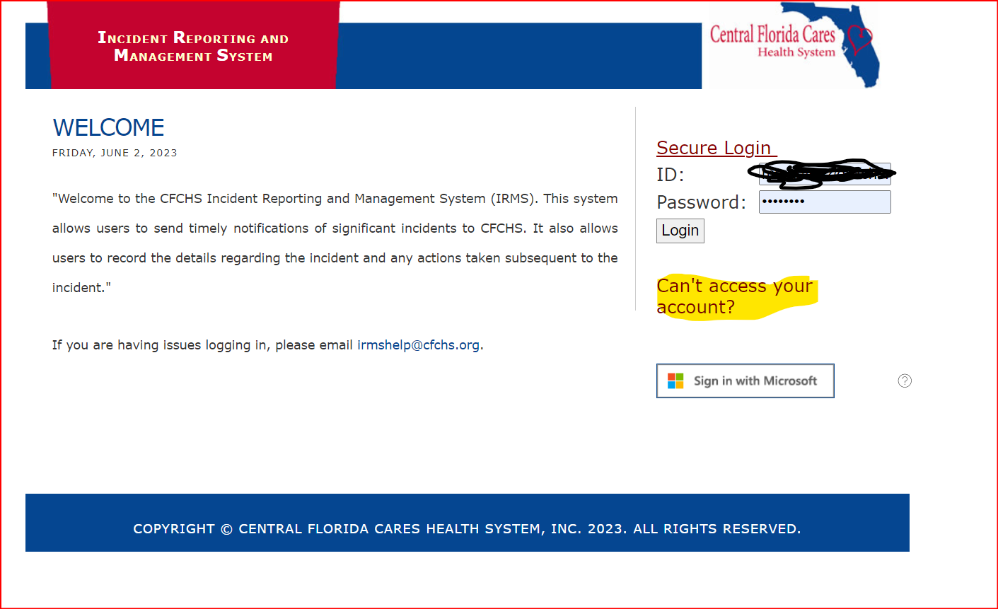
Accessing REPORTING Systems- What's New
Multifactor Authentication (MFA): Enhances IRMS and SIPP security by requiring users to identify by more than a username and password. A real-time provided 6-digit pin is now required for authentication and can be obtained by using an authenticator application, email, or SMS (text).
Single Sign-On (SSO): Authentication option that allows users to login using the username and password currently used for their organization.
In order to access IRMS one of the above must be active on your computer.
If you can't login please click on the can't access account marked in yellow on slide for reference

Slide 5
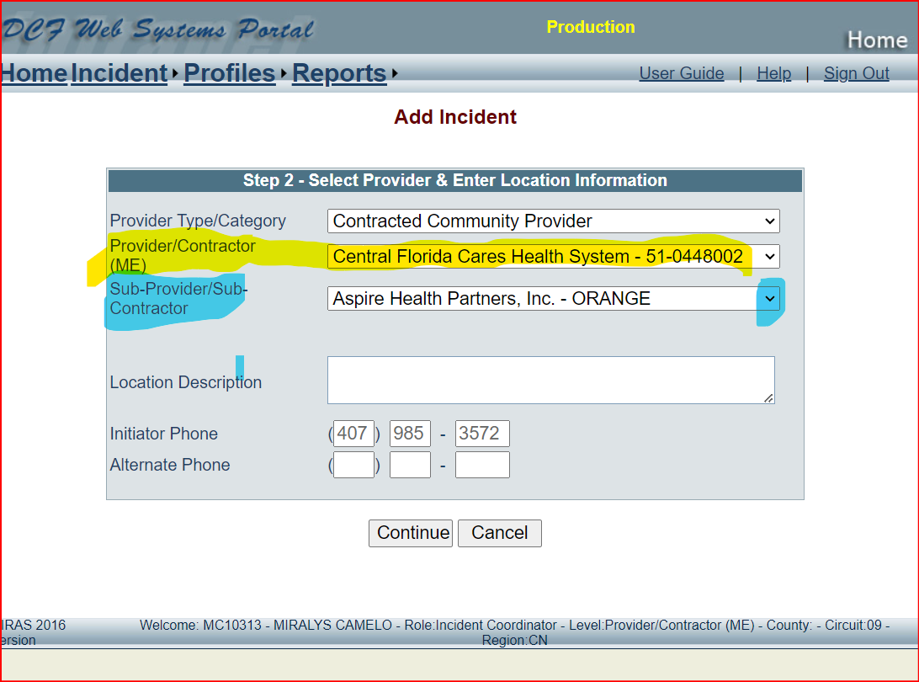
DCF Incident Reporting and Analysis System (IRAS)
Report In DCF IRAS all reportable events as categorized in CFOP 215-6 and CFOP 180-4
When an event meeting CFOP 215-6 criteria occurs and is tied to CFC you are to Select CFC as the ME in incidents that involve from the drop down under Subcontractors for:
CFC funded persons served
Provider employees
Facilities
Any incident that has, or potentially could have, a significant impact on persons served, the provider, the community, CFC or DCF.
The description of the incident should include as much detail as possible (max count of 500 characters)
Provide: What, When, Where, How
Do not include Name of persons Involved in this field
Notify CFC via phone call at (407) 985-3568 within fours hours of discovery of the incident if the incident is:
Severe
Possibly life threatening
There is actual or potential media involvement
Interruption of program services at the facility

Slide 6
CFC Incident Reporting Management System (IRMS)
Most fields mirror the DCF IRAS system.
Site where the incident report follow up takes place.
IRMS notifies you of comments (questions via cell phone text message or e-mail)
Answer follow up questions as soon as possible and no later than five (5 business days) Document if info requested is not available yet.
Some additional fields
Guardian or Parental Notification
Limited PHI for non-funded individuals
Allows document upload- OIG Notifications, DCF HIPAA Summary Form, and Decision Tree-
Provide Information on the agency’s action steps to prevent similar occurrences and mitigate risk.
If the provider has no incidents reported complete the attestation in IRMS by logging in within the first 5 days of the following month.

Slide 7
IMPORTANT
Incidents involving individuals with funding sources other than CFC still need to be reported to IRAS if the provider is licensed by the DCF (SA) or designated as a Baker Act Receiving Facility. In those situations, do NOT report under CFC, but directly under the provider’s name.
Exception-Employee Misconducts

Slide 8
Dcf Operating Procedures (CFOP) guiding Incident reporting
Incident Reporting and Management System (IRAS)
215-6
Security of Data and Information Technology Resources
50-2
Mandatory Reporting to the Office of the Inspector General (OIG)
180-4
CFOPs available at Search | Florida DCF (myflfamilies.com)

Slide 9
CFOP215-6 Categories
Death
Child Arrest (adjudicated to DCF)
Elopement
Employee Misconduct
Child on Child Sexual Abuse
Employee Arrest
Significant Injury to Staff/Clients
Suicide Attempt
Other
Sexual Abuse/Sexual Battery
Security Incident Unintentional
Missing Child (adjudicated to DCF)
Report within one business day in DCF IRAS
Notes:
Categories under CFOP 215-6 and required to be reported within one business day of incident occurrence

Slide 10
Death
Report deaths of
Active inpatient
Active outpatient
If a death occurs within 30 days of discharge.
Do not report deaths of individuals who have been discharged more than 30 days ago, unless there is media involvement.
An individual’s death while at a state hospital
Report if still providing any type of services to the individual, as they would still be considered as receiving services of the provider (FACT, Forensic Case Management, etc.) or if within 30 days of discharge.
Complete the “Cause of Death” section and update the incident when the autopsy results are available.

Slide 11
Employee arrest
215-6 f. –”The arrest of an employee of the Department or its contracted or licensed service provider for a civil or criminal offense.”
Train employees to report to HR any arrest.
DCF and the provider will receive notification of an employee arrest since the AHCA Clearinghouse and law enforcement agencies databases are now connected.
Report within one business day of receiving the notification

Slide 12
Employee misconduct
CFOP 215-6:
Work-related conduct or activity of an employee of the Department or its contracted or licensed service providers that results in potential liability for the Department; death or harm to an individual served; abuse, neglect or exploitation of an individual served; or results in a violation of statute, rule, regulation, or policy.
Includes CFOP 180-4
”Suspected or confirmed allegations of wrongdoing by an employee or contractor of the Department.”
Applies to all employees of DCF, contracted providers, and subcontracted providers.
Report alleged incident and follow up the reported info with verified details once report has been submitted
Please include ALL employee misconduct issues (not restricted to CFC funded programs, staff may rotate within different programs/units AND issues of employee misconduct may get media involvement).

Slide 13
CFOP 180-4 OIG Notifications Allegations of Suspected or confirmed employee wrongdoing
Contract Mismanagement
Fraud
Theft
Confidentiality
Breach
Failure to Report Abuse/Neglect
Any violation of Statute, Code, Regulation
Any violation that will result in disqualification from having individual's served contact duties
Falsification of Records
Computer Misconduct
Misuse of position (employee misconduct), property, equipment, etc.
Report within two business days
form CF 1934, available in DCF Forms)

Slide 14
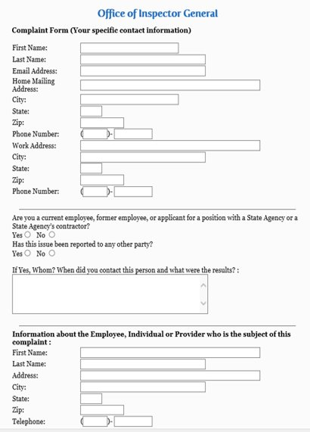
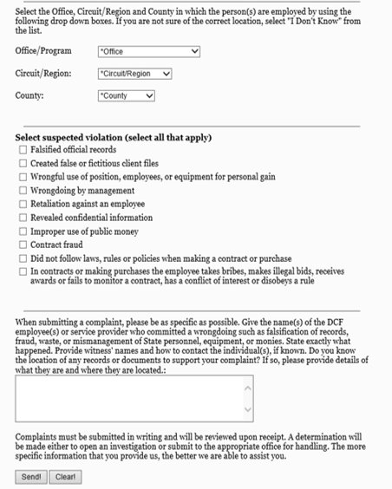
How to report to the OIG? 1. DCF Form CF 1934 2. http://www.dcf.state.fl.us/admin/ig/rptfraud1.shtml 3. IG.Complaints@myflfamilies.com

Slide 15
Security Incident-Unintentional CFOP 50-2 Security of Data and information Technology Resources Breach Related
IRAS
1 BD
OIG
2 BD
Notify DCF:
SAMH Contract Manager
DCF Security Officer
DCF Civil Rights Officer
5 BD
IF breach & less than 500 affected ?
Notify Individual(s)
45 BD
If breach & more than 500 affected?
Notify via Media within 45 BD & HHS within 60 days
Notify HHS at the end of the year
DCF HIPAA Breach Decision Tree
DCF HIPAA Incident Security Form
5 BD

Slide 16
Significant Injury
Could be to Staff or to Individual(s) served
Includes “Severe bodily trauma”
Must be as a result of work- related activity for staff
Injury caused by self harm
No need to report:
Minor situations that are addressed at the provider level
If send-offs for medical clearance are precautionary, requested, or caused by medical conditions but do not involve severe bodily trauma.
Do report if hospitalization is required after further medical assessment.

Slide 17
Elopement
CFOP 215-6, 5.
(1) The unauthorized absence beyond four hours of an adult during involuntary civil placement within a Department-operated, Department-contracted or licensed service provider.
(2) The unauthorized absence of a forensic individual's served on conditional release in the community.
(3) The unauthorized absence of any individual in a Department contracted or licensed residential substance abuse and/or mental health program.
Does this include AMA clients?
If the individual's served is part of a residential program or inpatient, then “elopement" applies to them. Elopement does not apply to outpatient.

Slide 18
Other
CFOP 215-6, 5.
Any major event not previously identified as a reportable critical incident but has, or is likely to have, a significant impact on the Department, or its provider(s). These events may include but are not limited to:
(1) Human acts that jeopardize the health, safety, or welfare of individuals such as kidnapping, riot, or hostage situation;
(2) Bomb or biological/chemical threat of harm to personnel or property involving an explosive device or biological/chemical agent received in person, by telephone, in writing, via mail, electronically, or otherwise;
(3) Theft, vandalism, damage, fire, sabotage, or destruction of state or private property of significant value or importance;
(4) Death of an employee or visitor while on the grounds of the Department or one of its contracted or licensed providers;
(5) Significant injury of a visitor (who is not an individual served ) while on the grounds of the Department or one of its contracted, designated, or licensed providers; or,
(6) Events regarding Department program and/or persons served of contracted or licensed service providers that have led to or may lead to media reports.

Slide 19
In the “Description” field include a complete summary of the incident no longer than 500 characters. Additional information should be included in the “Comments” section.
Do NOT include PHI as part of the incident description.
Include in DCF IRAS if the guardian was notified
The Subject of Incident = Recipient (person who got injured whose PHI might have been compromised, etc.)
The “Possible Responsible Person”=Actor (individual who caused the injury, exposed the PHI, etc.)
Submit only one incident for each event, even when several people are involved.
No need to report medical appointments for pregnant women, or hospital send-off for delivery if in residential facility
No need to report initiation of a Baker Act unless there are injuries, facility damage, or alteration of service provision involved, or person served elopes after admission.
Do report under Other any facility issues that may disrupt the provision of services to individuals served.
Reminders…

Slide 20

Ask for assistance…
If there are incidents outside of what is specifically stated in the CFOPs or left to discretion due to the "impact on individual, provider and/or Department/DCF" then the provider can consult with either CFC or the Department/DCF.

Slide 21

Questions
still need help… contact CFC Compliance Dept ☺
Miralys Martinez
Risk Management Specialist mmartinez@cfchs.org
Geovanna Gonzalez
Compliance Director ggonzalez@cfchs.org
THANK YOU

